Slide 1
CS162 Operating Systems and Systems Programming Lecture 3 Processes (con’t), Fork, Introduction to I/O
August 29th, 2018
Prof. Ion Stoica
http://cs162.eecs.Berkeley.edu

Slide 2
Recall: Four fundamental OS concepts
Thread
Single unique execution context
Program Counter, Registers, Execution Flags, Stack
Address Space w/ translation
Programs execute in an address space that is distinct from the memory space of the physical machine
Process
An instance of an executing program is a process consisting of an address space and one or more threads of control
Dual Mode operation/protection
Only the “system” has the ability to access certain resources
The OS and the hardware are protected from user programs and user programs are isolated from one another by controlling the translation from program virtual addresses to machine physical addresses

Slide 3
Recall: A simple address translation w/ Base & Bound
0000…
0000…
code
code
Static Data
Addresses translated on-the-fly
Static Data
heap
heap
stack
Base Address
stack
1000…
1000…
0010…
code
Program
address
0010…
Static Data
heap
Bound
<
stack
1100…
0100…
Can the program touch OS?
Can it touch other programs?
FFFF…

Slide 4
Tying it together: Simple B&B: OS loads process
0000…
Proc 1
Proc 2
Proc n
code
…
Static Data
OS
heap
stack
sysmode
1
1000…
code
Base
xxxx …
0000…
Static Data
Bound
xxxx…
FFFF…
heap
uPC
xxxx…
stack
1100…
PC
code
3000…
regs
Static Data
…
heap
stack
3080…
FFFF…

Slide 5
Simple B&B: OS gets ready to execute process
0000…
Proc 1
Proc 2
Proc n
code
RTU
…
Static Data
OS
heap
stack
sysmode
1
1000…
code
Privileged Inst: set special registers for Proc 2
RTU
Base
1000 …
0000…
Static Data
Bound
0100…
FFFF…
heap
uPC
0001…
stack
1100…
PC
code
3000…
regs
00FF…
Static Data
…
heap
stack
3080…
FFFF…

Slide 6
Simple B&B: User Code Running
0000…
Proc 1
Proc 2
Proc n
code
…
Static Data
OS
heap
stack
sysmode
0
1000…
code
Base
1000 …
0000…
Static Data
How does kernel switch between processes?
First question: How to return to system?
Bound
0100…
FFFF…
heap
uPC
xxxx…
stack
1100…
PC
0001…
code
3000…
regs
00FF…
Static Data
…
heap
stack
3080…
FFFF…

Slide 7
3 types of Mode Transfer
Syscall
Process requests a system service, e.g., exit
Like a function call, but “outside” the process
Does not have the address of the system function to call
Marshall the syscall id and args in registers and exec syscall
Interrupt
External asynchronous event triggers context switch
e. g., Timer, I/O device
Independent of user process
Trap or Exception
Internal synchronous event in process triggers context switch
e.g., Protection violation (segmentation fault), Divide by zero, …
All 3 are an UNPROGRAMMED CONTROL TRANSFER

Slide 8
How do we get the system target address of the “unprogrammed control transfer?”

Slide 9
Example: Interrupt Vector
Address and properties of each interrupt handler
interrupt number (i)
intrpHandler_i () {
….
}
Where else do you see this dispatch pattern?

Slide 10
Simple B&B: User => Kernel
0000…
Proc 1
Proc 2
Proc n
code
…
Static Data
OS
heap
stack
sysmode
0
1000…
code
Base
1000 …
0000…
Static Data
Bound
0100…
FFFF…
heap
uPC
xxxx…
stack
1100…
PC
0000 1234
code
3000…
regs
00FF…
Static Data
How to return to system?
…
heap
stack
3080…
FFFF…

Slide 11
Simple B&B: Interrupt
0000…
Proc 1
Proc 2
Proc n
code
…
Static Data
OS
heap
stack
sysmode
1
1000…
code
Base
1000 …
0000…
Static Data
Bound
0100 …
FFFF…
heap
uPC
0000 1234
stack
1100…
PC
IntrpVector[i]
code
3000…
regs
00FF…
Static Data
How to save registers and set up system stack?
…
heap
stack
3080…
FFFF…

Slide 12
Simple B&B: Switch User Process
0000…
Proc 1
Proc 2
Proc n
code
RTU
…
Static Data
OS
heap
stack
sysmode
1
1000…
1000 …
code
Base
3000 …
0000…
Static Data
0100 …
Bound
0080 …
FFFF…
heap
0000 1234
uPC
0000 0248
regs
stack
1100…
PC
0001 0124
00FF…
code
3000…
regs
00D0…
Static Data
How to save registers and set up system stack?
…
heap
stack
3080…
FFFF…

Slide 13
Simple B&B: “resume”
0000…
Proc 1
Proc 2
Proc n
code
RTU
…
Static Data
OS
heap
stack
sysmode
0
1000…
1000 …
code
Base
3000 …
0000…
Static Data
0100 …
Bound
0080 …
FFFF…
heap
0000 1234
uPC
xxxx xxxx
regs
stack
1100…
PC
000 0248
00FF…
code
3000…
regs
00D0…
Static Data
How to save registers and set up system stack?
…
heap
stack
3080…
FFFF…

Slide 14
Process Control Block
(Assume single threaded processes for now)
Kernel represents each process as a process control block (PCB)
Status (running, ready, blocked, …)
Registers, SP, … (when not running)
Process ID (PID), User, Executable, Priority, …
Execution time, …
Memory space, translation tables, …
Kernel Scheduler maintains a data structure containing the PCBs
Scheduling algorithm selects the next one to run

Slide 15
Recall: give the illusion of multiple processors?
vCPU1
vCPU2
vCPU3
vCPU1
vCPU2
vCPU3
vCPU1
vCPU2
Shared Memory
Time
Assume a single processor. How do we provide the illusion of multiple processors?
Multiplex in time!
Multiple “virtual CPUs”
Each virtual “CPU” needs a structure to hold, i.e., PCB:
Program Counter (PC), Stack Pointer (SP)
Registers (Integer, Floating point, others…?)
How switch from one virtual CPU to the next?
Save PC, SP, and registers in current PCB
Load PC, SP, and registers from new PCB
What triggers switch?
Timer, voluntary yield, I/O, other things

Slide 16
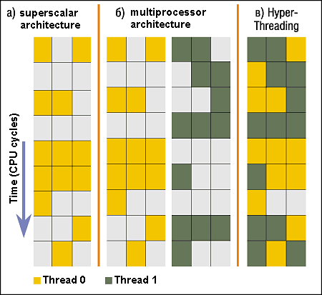
Simultaneous MultiThreading/Hyperthreading
Hardware technique
Superscalar processors can execute multiple instructions that are independent
Hyperthreading duplicates register state to make a second “thread,” allowing more instructions to run
Can schedule each thread as if were separate CPU
But, sub-linear speedup!
Original technique called “Simultaneous Multithreading”
http://www.cs.washington.edu/research/smt/index.html
SPARC, Pentium 4/Xeon (“Hyperthreading”), Power 5
Colored blocks show
instructions executed
Notes:
Intel seems to be discarding SMT in Silvermont because of power problems

Slide 17
Scheduler
if ( readyProcesses(PCBs) ) {
nextPCB = selectProcess(PCBs);
run( nextPCB );
} else {
run_idle_process();
}
Scheduling: Mechanism for deciding which processes/threads receive the CPU
Lots of different scheduling policies provide …
Fairness or
Realtime guarantees or
Latency optimization or ..

Slide 18
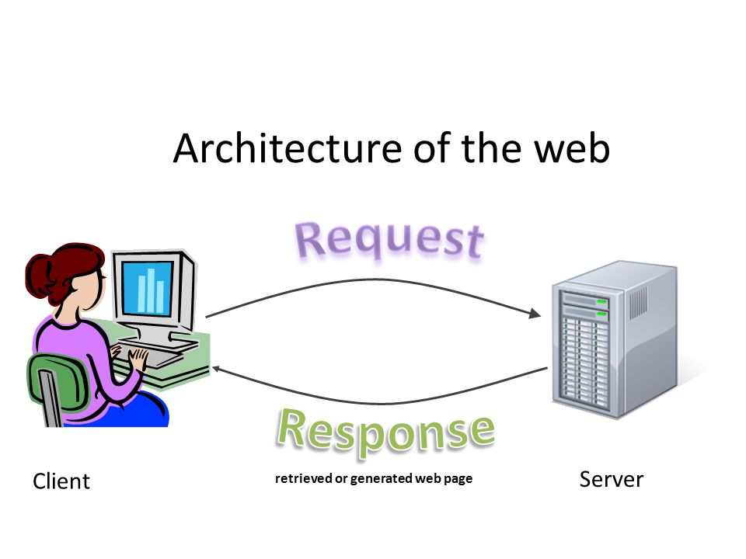
Putting it together: web server
Request
Reply
(retrieved by web server)
Client
Web Server

Slide 19
Putting it together: web server
Server
4. parse request
9. format reply
request
buffer
reply
buffer
network
socket
read
3. kernel
copy
10. network
socket
write
5. file
read
8. kernel
copy
syscall
syscall
Kernel
wait
RTU
11. kernel copy
from user buffer
to network buffer
RTU
interrupt
interrupt
2. copy arriving
packet (DMA)
12. format outgoing
packet and DMA
6. disk
request
7. disk data
(DMA)
Hardware
Network
interface
Disk interface
Request
Reply

Slide 20
Recall: User/Kernel (Privileged) Mode
User Mode
interrupt
exception
syscall
rtn
rfi
Kernel Mode
exit
exec
Limited HW access
Full HW access

Slide 21
Implementing Safe Kernel Mode Transfers
Important aspects:
Controlled transfer into kernel (e.g., syscall table)
Separate kernel stack
Carefully constructed kernel code packs up the user process state and sets it aside
Details depend on the machine architecture
Should be impossible for buggy or malicious user program to cause the kernel to corrupt itself

Slide 22
Need for Separate Kernel Stacks
Kernel needs space to work
Cannot put anything on the user stack (Why?)
Two-stack model
OS thread has interrupt stack (located in kernel memory) plus User stack (located in user memory)
Syscall handler copies user args to kernel space before invoking specific function (e.g., open)
Interrupts (???)

Slide 23
Before

Slide 24
During

Slide 25
Kernel System Call Handler
Vector through well-defined syscall entry points!
Table mapping system call number to handler
Locate arguments
In registers or on user (!) stack
Copy arguments
From user memory into kernel memory
Protect kernel from malicious code evading checks
Validate arguments
Protect kernel from errors in user code
Copy results back
Into user memory

Slide 26
How Does the Kernel Provide Services?
You said that applications request services from the operating system via syscall, but …
I’ve been writing all sort of useful applications and I never ever saw a “syscall” !!!
That’s right.
It was buried in the programming language runtime library (e.g., libc.a)
… Layering

Slide 27
OS Run-Time Library
Proc 1
Proc 2
Proc n
…
OS
Appln
login
Window Manager
…
OS library
OS library
OS library
OS

Slide 28
A Kind of Narrow Waist
Word Processing
Compilers
Web Browsers
Email
Databases
Web Servers
Application / Service
Portable OS Library
OS
User
System Call
Interface
System
Portable OS Kernel
Software
Platform support, Device Drivers
Hardware
x86
PowerPC
ARM
PCI
Ethernet (1Gbs/10Gbs)
802.11 a/g/n/ac
SCSI
Graphics
Thunderbolt

Slide 29
Administrivia: Getting started
THIS Friday (8/31) is early drop day! Very hard to drop afterwards…
Work on Homework 0 due on Tuesday!
Get familiar with all the cs162 tools
Submit to autograder via git
Participation: Attend section! Get to know your TA!
Group sign up via autograder then TA form next week
Get finding groups of 4 people ASAP
Priority for same section; if cannot make this work, keep same TA

Slide 30
5 min break

Slide 31
Hardware support: Interrupt Control
Interrupt processing not visible to the user process:
Occurs between instructions, restarted transparently
No change to process state
What can be observed even with perfect interrupt processing?
Interrupt Handler invoked with interrupts ‘disabled’
Re-enabled upon completion
Non-blocking (run to completion, no waits)
Pack up in a queue and pass off to an OS thread for hard work
wake up an existing OS thread

Slide 32
Hardware support: Interrupt Control
OS kernel may enable/disable interrupts
On x86: CLI (disable interrupts), STI (enable)
Atomic section when select next process/thread to run
Atomic return from interrupt or syscall
HW may have multiple levels of interrupts
Mask off (disable) certain interrupts, eg., lower priority
Certain Non-Maskable-Interrupts (NMI)
e.g., kernel segmentation fault

Slide 33
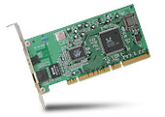
Interrupt Controller
Interrupt Mask
Priority Encoder
IntID
CPU
Interrupt
Int Disable
Timer
Software
Interrupt
Control
NMI
Network
Interrupts invoked with interrupt lines from devices
Interrupt controller chooses interrupt request to honor
Interrupt identity specified with ID line
Mask enables/disables interrupts
Priority encoder picks highest enabled interrupt
Software Interrupt Set/Cleared by Software
CPU can disable all interrupts with internal flag
Non-Maskable Interrupt line (NMI) can’t be disabled

Slide 34
How do we take interrupts safely?
Interrupt vector
Limited number of entry points into kernel
Kernel interrupt stack
Handler works regardless of state of user code
Interrupt masking
Handler is non-blocking
Atomic transfer of control
“Single instruction”-like to change:
Program counter
Stack pointer
Memory protection
Kernel/user mode
Transparent restartable execution
User program does not know interrupt occurred

Slide 35
Can a process create a process ?
Yes! Unique identity of process is the “process ID” (or PID)
fork() system call creates a copy of current process with a new PID
Return value from fork(): integer
When > 0:
Running in (original) Parent process
return value is pid of new child
When = 0:
Running in new Child process
When < 0:
Error! Must handle somehow
Running in original process
All state of original process duplicated in both Parent and Child!
Memory, File Descriptors (next topic), etc…

Slide 36
fork1.c
#include <stdlib.h>
#include <stdio.h>
#include <string.h>
#include <unistd.h>
#include <sys/types.h>
#define BUFSIZE 1024
int main(int argc, char *argv[])
{
char buf[BUFSIZE];
size_t readlen, writelen, slen;
pid_t cpid, mypid;
pid_t pid = getpid(); /* get current processes PID */
printf("Parent pid: %d\n", pid);
cpid = fork();
if (cpid > 0) { /* Parent Process */
mypid = getpid();
printf("[%d] parent of [%d]\n", mypid, cpid);
} else if (cpid == 0) { /* Child Process */
mypid = getpid();
printf("[%d] child\n", mypid);
} else {
perror("Fork failed");
exit(1);
}
exit(0);
}

Slide 37
fork2.c
int status;
pid_t = tcpid;
…
cpid = fork();
if (cpid > 0) { /* Parent Process */
mypid = getpid();
printf("[%d] parent of [%d]\n", mypid, cpid);
tcpid = wait(&status);
printf("[%d] bye %d(%d)\n", mypid, tcpid, status);
} else if (cpid == 0) { /* Child Process */
mypid = getpid();
printf("[%d] child\n", mypid);
}
…

Slide 38
Process Races: fork3.c
int i;
cpid = fork();
if (cpid > 0) {
mypid = getpid();
printf("[%d] parent of [%d]\n", mypid, cpid);
for (i=0; i<10; i++) {
printf("[%d] parent: %d\n", mypid, i);
// sleep(1);
}
} else if (cpid == 0) {
mypid = getpid();
printf("[%d] child\n", mypid);
for (i=0; i>-10; i--) {
printf("[%d] child: %d\n", mypid, i);
// sleep(1);
}
}
Question: What does this program print?
Does it change if you add in one of the sleep() statements?

Slide 39
UNIX Process Management
UNIX fork – system call to create a copy of the current process, and start it running
No arguments!
UNIX exec – system call to change the program being run by the current process
UNIX wait – system call to wait for a process to finish
UNIX signal – system call to send a notification to another process
UNIX man pages: fork(2), exec(3), wait(2), signal(3)
Notes:
UNIX splits creating a process into two steps, each of them a lot simpler.

Slide 40
UNIX Process Management
Notes:
How is this used – typically, fork a process, child and parent are now both running the same program. One sets up the child program, and runs exec – becoming the new program
The parent, usually, waits for the child to finish

Slide 41
Shell
A shell is a job control system
Allows programmer to create and manage a set of programs to do some task
Windows, MacOS, Linux all have shells
Example: to compile a C program
cc –c sourcefile1.c
cc –c sourcefile2.c
ln –o program sourcefile1.o sourcefile2.o
./program
HW1

Slide 42
Signals – infloop.c
#include <stdlib.h>
#include <stdio.h>
#include <sys/types.h>
#include <unistd.h>
#include <signal.h>
void signal_callback_handler(int signum)
{
printf("Caught signal %d - phew!\n",signum);
exit(1);
}
int main() {
signal(SIGINT, signal_callback_handler);
while (1) {}
}
Got top?

Slide 43
Summary
Process: execution environment with Restricted Rights
Address Space with One or More Threads
Owns memory (address space)
Owns file descriptors, file system context, …
Encapsulate one or more threads sharing process resources
Interrupts
Hardware mechanism for regaining control from user
Notification that events have occurred
User-level equivalent: Signals
Native control of Process
Fork, Exec, Wait, Signal

